Slide 1


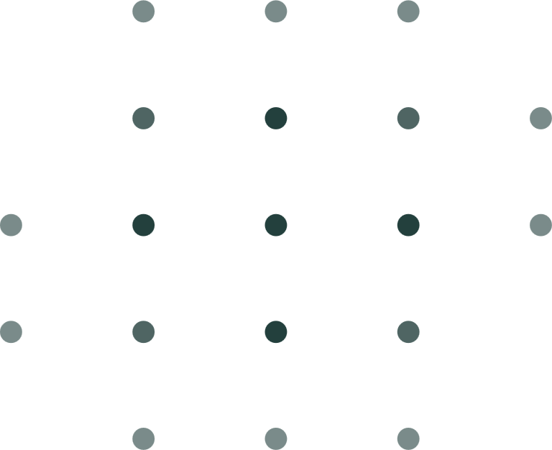

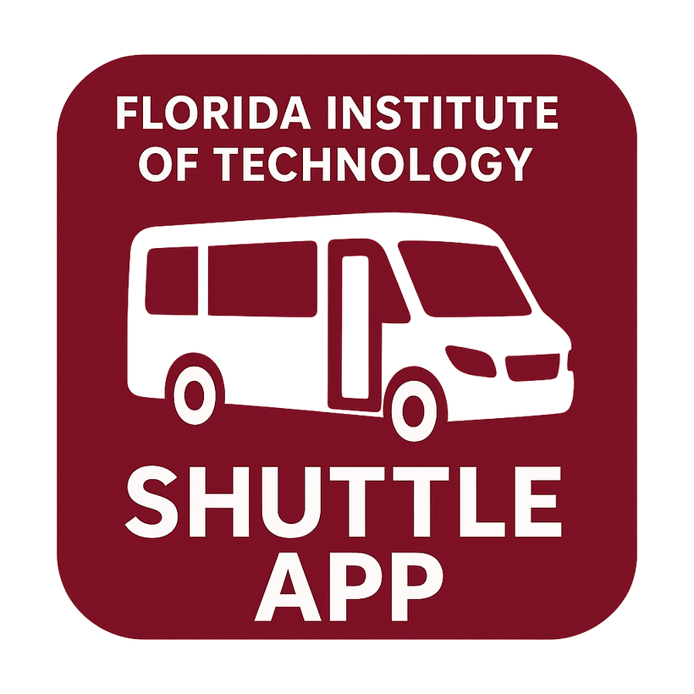

PANTHER SHUTTLE APP
https://yanarex.github.io/shuttle-app/
Members: Joseph Hilte, Tony Arrington, Jonathan Suo, and Chase Monigle

Slide 2



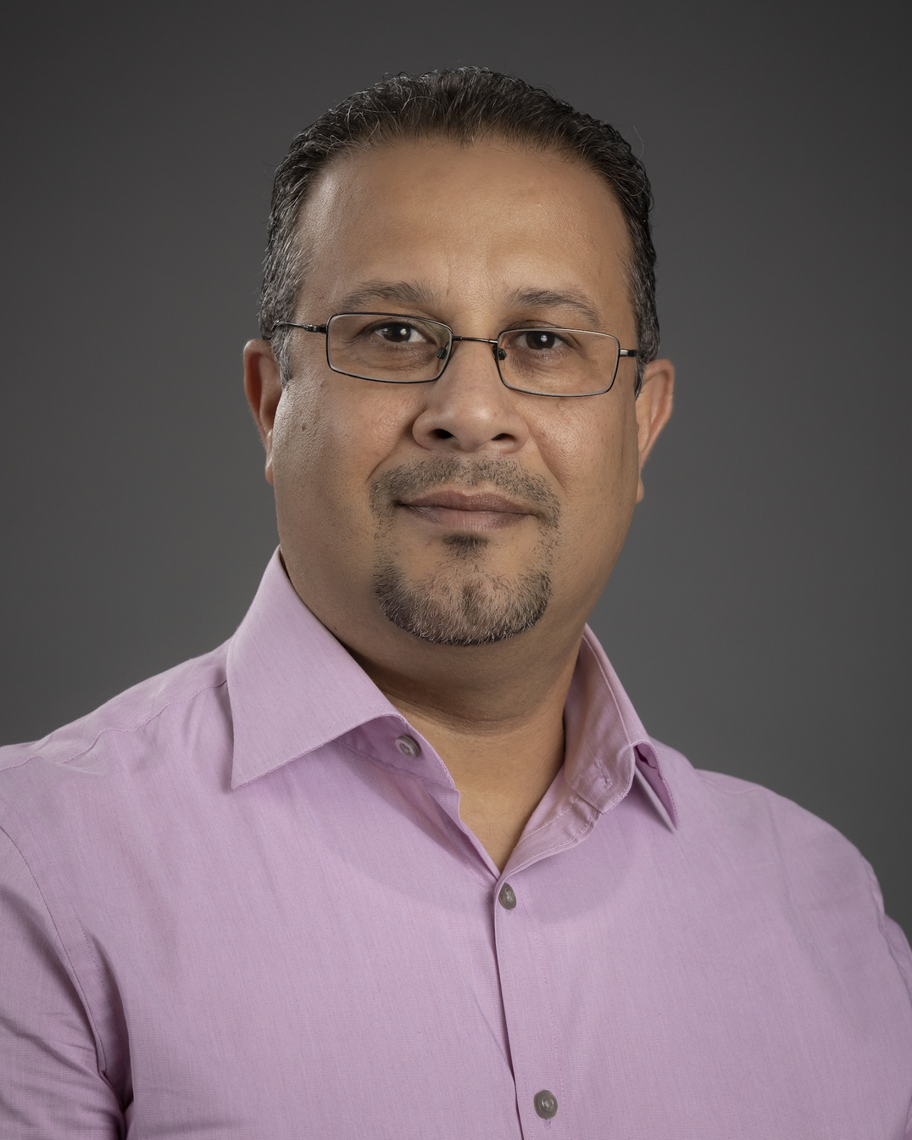




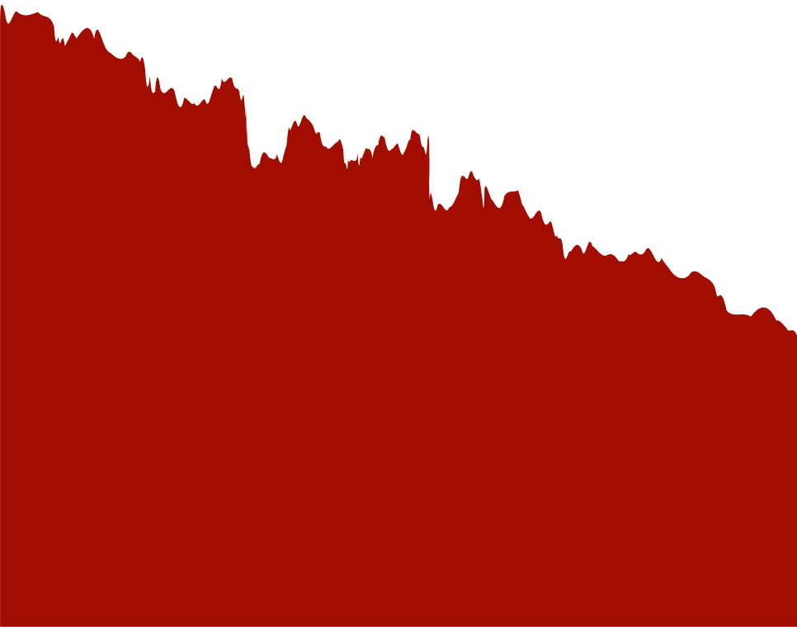
Who is involved?
Faculty Advisor: Professor Khaled Ali Slhoub
Serving as the academic mentor for this project, providing guidance on methodology, research direction, and overall academic rigor.
Client: Student Vincent Borrelli
Acting as the project user/tester, offering domain expertise, and ensuring that the outcome align with the client’s needs.

Slide 3


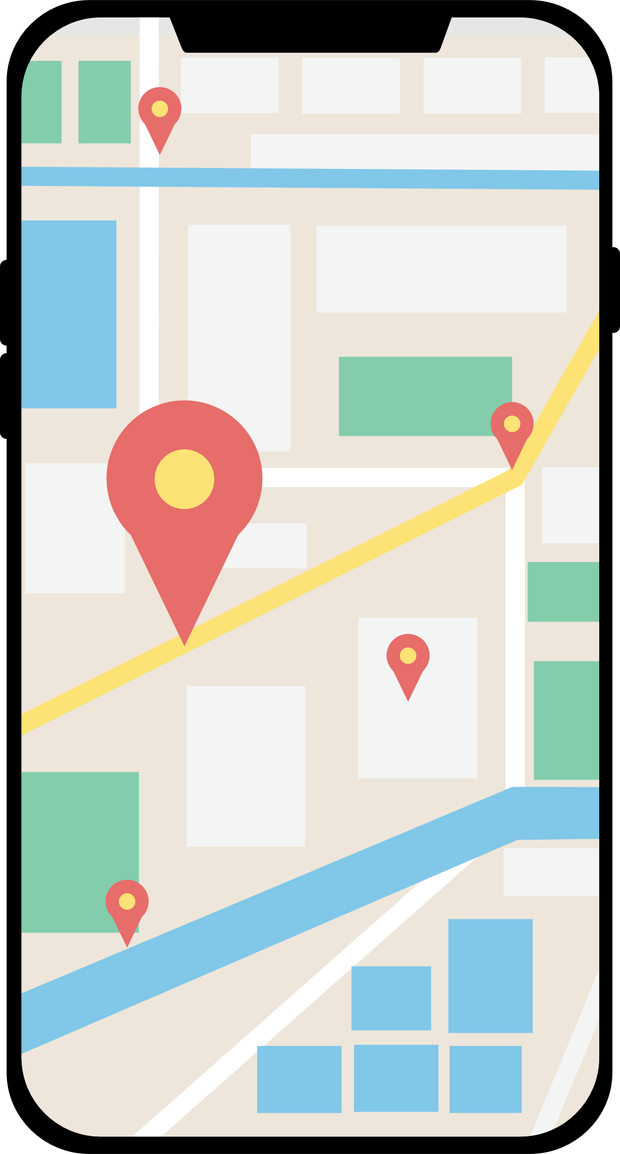



Risk Management
Goals:
Motivation:
App for Florida Tech Students
Lack of Info about shuttle
User Friendly / Easily Availible
Not enough parking on campus
Reliable Notifications
Shuttle has low use.

Slide 4



Key Features
Info
The user can see the shuttle schedule.
Notification
Be notified 30, 15, and 5 minutes before a shuttle reaches a designated location.
Tracking
See shuttle on live map.
Booking
User can alert / request pickup

Slide 5
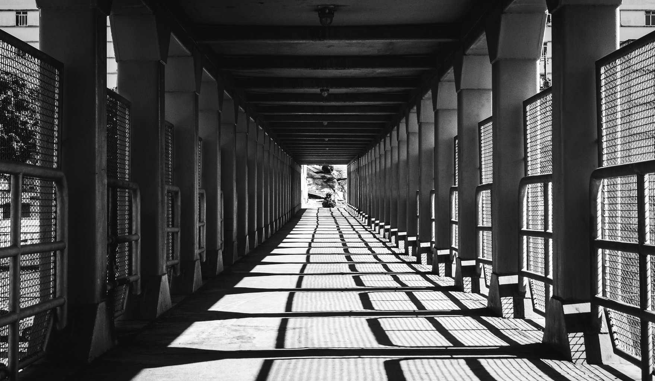
Novel Features
  Predictive Arrival Times – Uses machine learning to estimate when a shuttle will arrive based on traffic, past delays, and rider demand.
  Crowd Level Indicators – Shows how full each shuttle is (via driver input or student check-ins), so students can decide whether to wait for the next one.
  Integration with Campus Services – Links events so students can plan transportation around them.
  Update - First update to anything Panther Shuttle related.

Slide 6



Technical Challenges
Real-time location accuracy
GPS jitter, urban canyons, and device variance can cause jumpy pins.
First time developing app.
Not having much app development experience can hinder progress
Backend latency & scaling
Many clients polling can spike load before class change times.
Push notifications reliability
OS throttling and quiet hours can delay alerts

Slide 7










Project Milestones
Milestone 1
Milestone 2
Milestone 3
Milestone...
Compare and solidify technical tools.
Provide demo(s) to evaluate tools used.
Resolve any of our technical challenges.
Showcase our collaboration tools.
Create Requirement Document
Create Design Document
Create Test Plan
Have a running version of the application on Android.
Implement a basic GUI.
Implement the Shuttle Schedule to be viewed (as PDF)
Implement a base framework for the interface.
Improve GUI to look better
Implement ability to sign in using FIT login.
Implement the beginnings of the mapping system.
Implement beginnings of the notification system.
To be continued

Slide 8
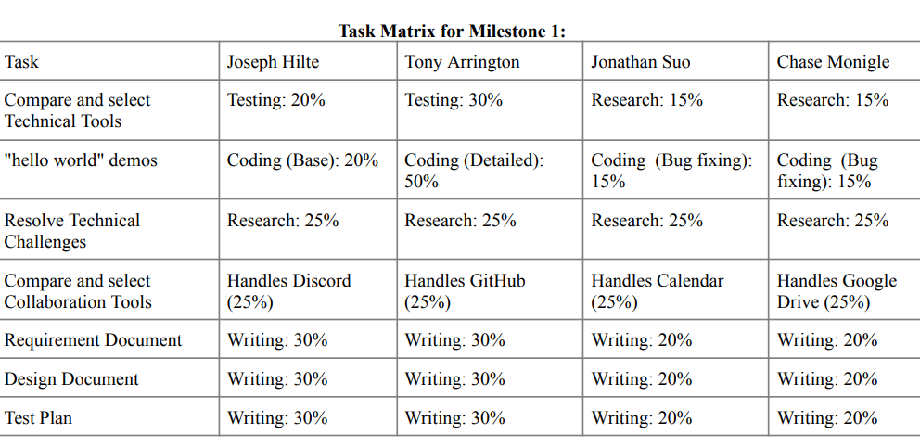

Slide 9





QUESTIONS?
Visit our website
https://yanarex.github.io/shuttle-app/

